Slide 1
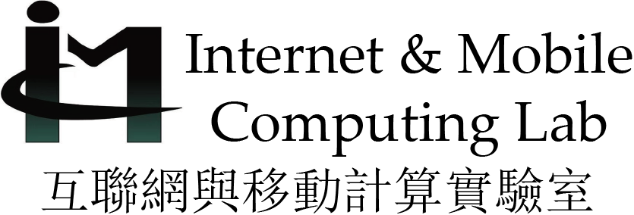
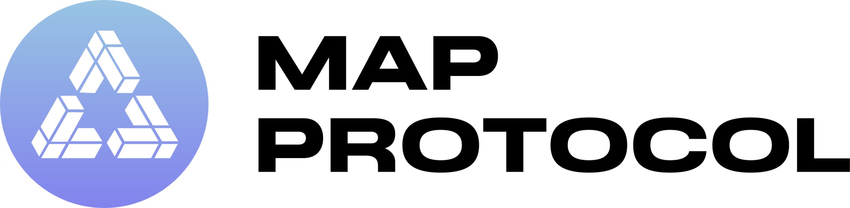



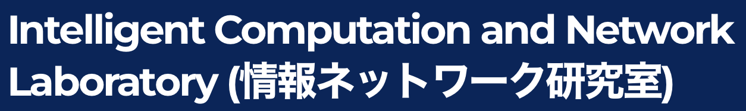

MAP the Blockchain World: A Trustless and Scalable Blockchain
Interoperability Protocol for Cross-chain Applications
Yinfeng Cao, Jiannong Cao
The Hong Kong Polytechnic University (PolyU)
Accepted by The ACM Web Conference 2025 (WWW’25)
3 July 2025
Supported by HK RGC Research Impact Fund (No. R5034-18)
Research Institute for Artificial Intelligence of Things (RIAIoT)
Notes:
Hello everyone, very glad to be here, my name is yinfeng cao, a final year phd supervised by prof. Jiannong cao from department of computing.
Today, I will introduce our recent work about cryptocurrency and decentralized finanance

Slide 2
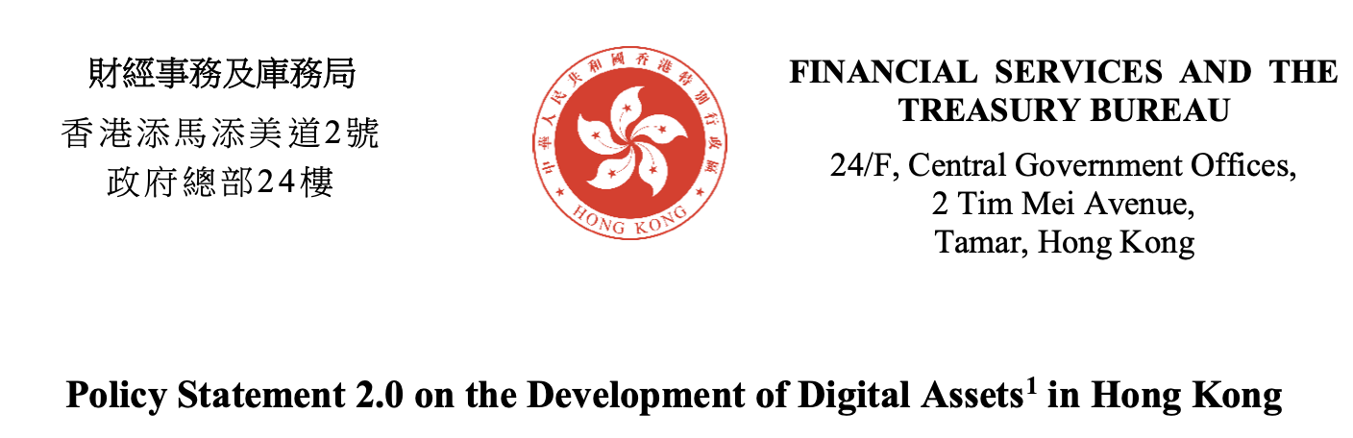

The New World of Web
Cryptocurrency and decentralized finance is rising
Decentralization, trustless, transparency
Bitcoin and other cryptocurrency has become widely recognized assets
Notes:
At first, I would like to know how many of you have or even invest cryptocurrency such as bitcoins? Did you make money from it?
As we may know, there are many news and new policies about cryptocurrency day by day, from authorities to . We can feel that Cryptocurrency is more and more important and reshaping the traditional finance. And In recent years, nevknow even bitcoin and many other cryptocurrency is recognized as a major assets

Slide 3
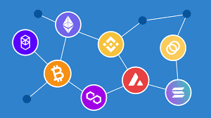
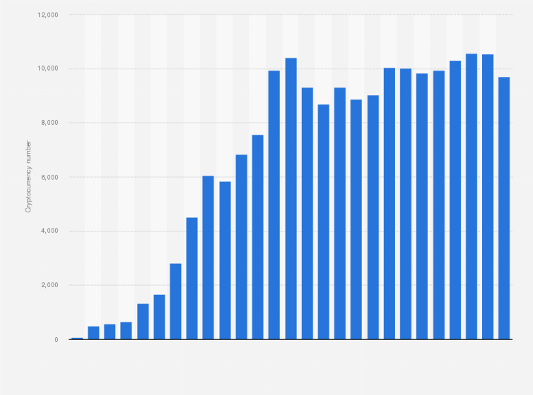
Massive Token Distribution and Isolation
Millions of tokens exist across different chains
Fungible Token (Ethereum)
Non-Fungible Token (Bitcoin, Ethereum, Solana)
RWAs (specialized chains)
Meme Coins (Solana, Binance Smart Chain)
…
Different chains are heterogeneous and isolated
One chain only host limited types of tokens
Users hold tokens simultaneously
How to securely and efficiently move tokens from one chain to another (aka cross-chain)?
Notes:
These flourish indeed happen, but also directly lead to a problem is that, as there are too many cryptocurrencys, and it is hard to efficiently manage them on different chains. Specially, first there are many types of tokens, from fungible tokens like Ethereum, to Non-Fugustbles tokens, Real-word assets, and even meme coins. And each chains can only host some of them, not all the tokens. Therefore, when user have tokens on multiple chains simultaneously or want to transfer token from one to another chain, it is very difficult. This is the cross-chain problem: How to securely and efficiently move tokens from one chain to another (aka cross-chain)?

Slide 4
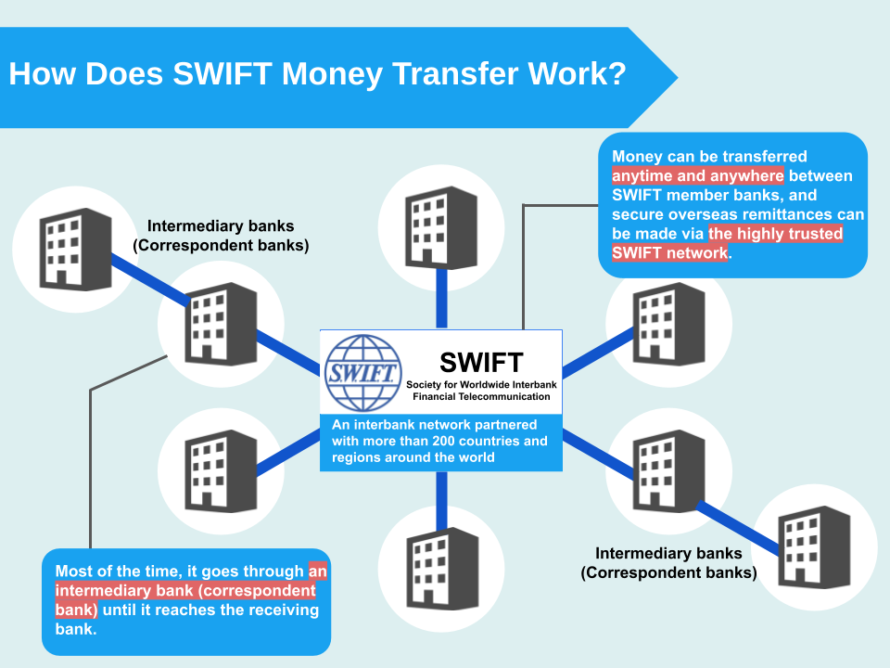
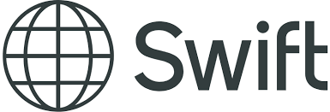
Analogy of Cross-chain Problem
Imagine chains as banks, while tokens as funds
Users transfer funds across multiple accounts
In different banks located at different countries
SWIFT system is widely used but trusted, centralized, and inefficient
Design a better “SWIFT” system
for tokens and chains
Notes:
Actually, for cross-chain problem, we can easily find an annology of it in traditional finiance. That is, we can imagine chains as banks, and our tokens as funds in the banks. When a user want to transfer fund from one bank to anther, especially internationally, he must go through the SWIFT system, which is a system to communicate and coordinate with many banks to realized interoperabilitby.
Similary, our target is

Slide 5
MAP Design Philosophy: Practicability
Requirements
Trustless: no trusted centralized parities
Low on-chain cost (gas consumption) and off-chain cost (computation)
Simple Deployment and easy to scale: no modification on chains to be connected & be able to connect existing running public chains

Slide 6
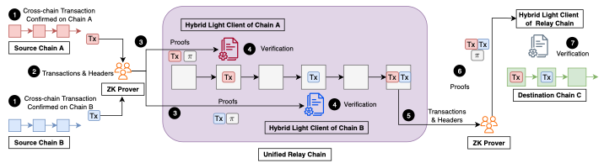
Unified Relay Chain Architecture
Achieve decentralized security & simply the deployment & easy to scale up
Introduce a trusless PoS relay chain between source chain (SC) and destination chain (DC)
Work as an intermediary but no single trusted parties
With Optimized cross-chain verification mechanism

Slide 7
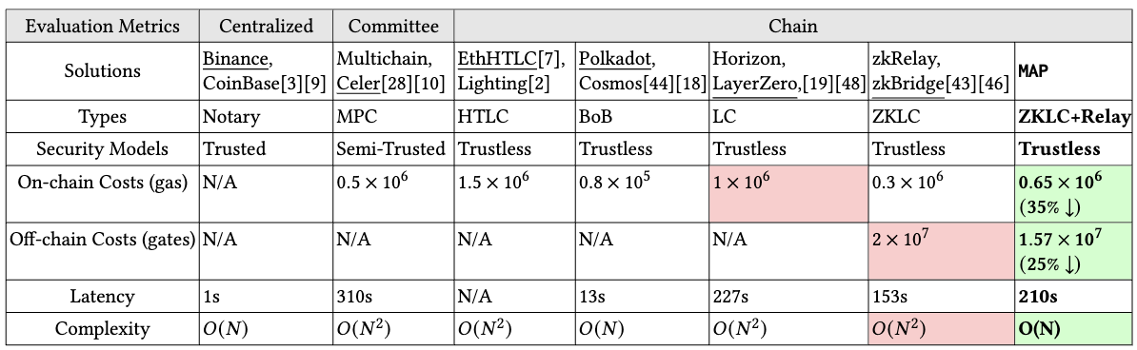
Performance and Security
Processing fees of a cross-chain transaction is reduced by 35% !

Slide 8
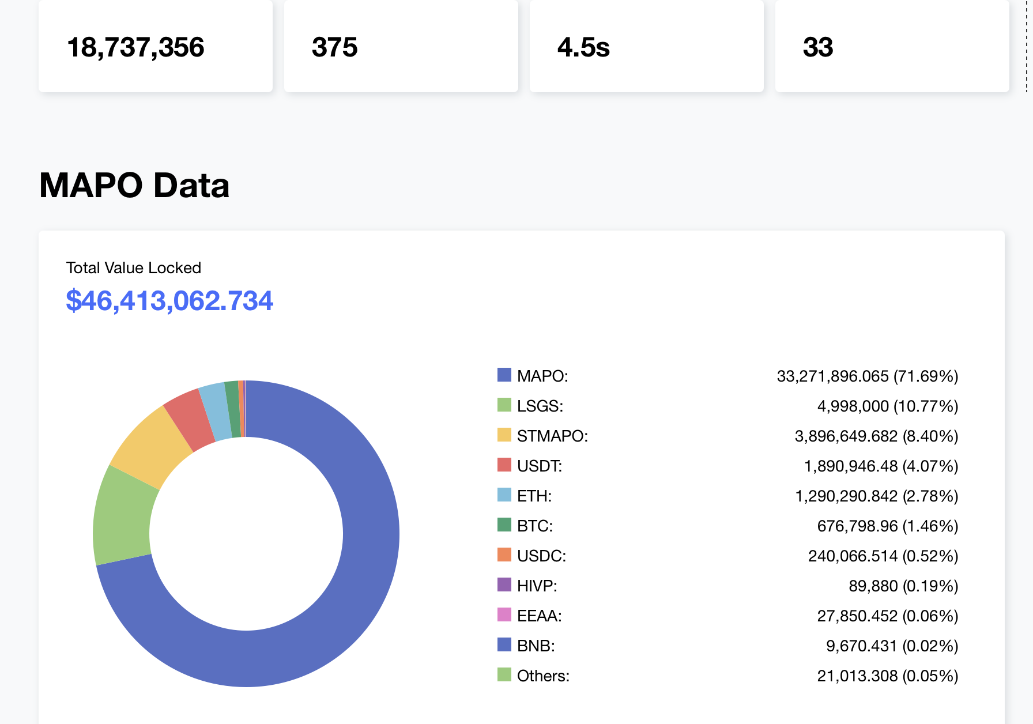
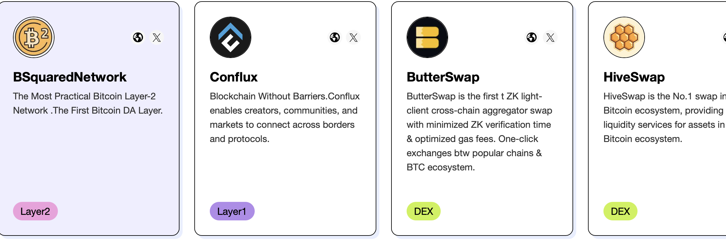
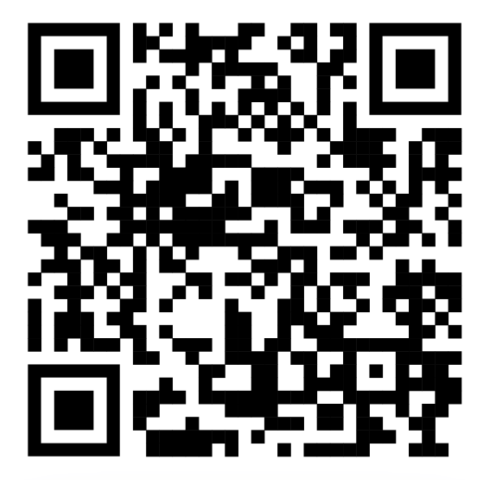
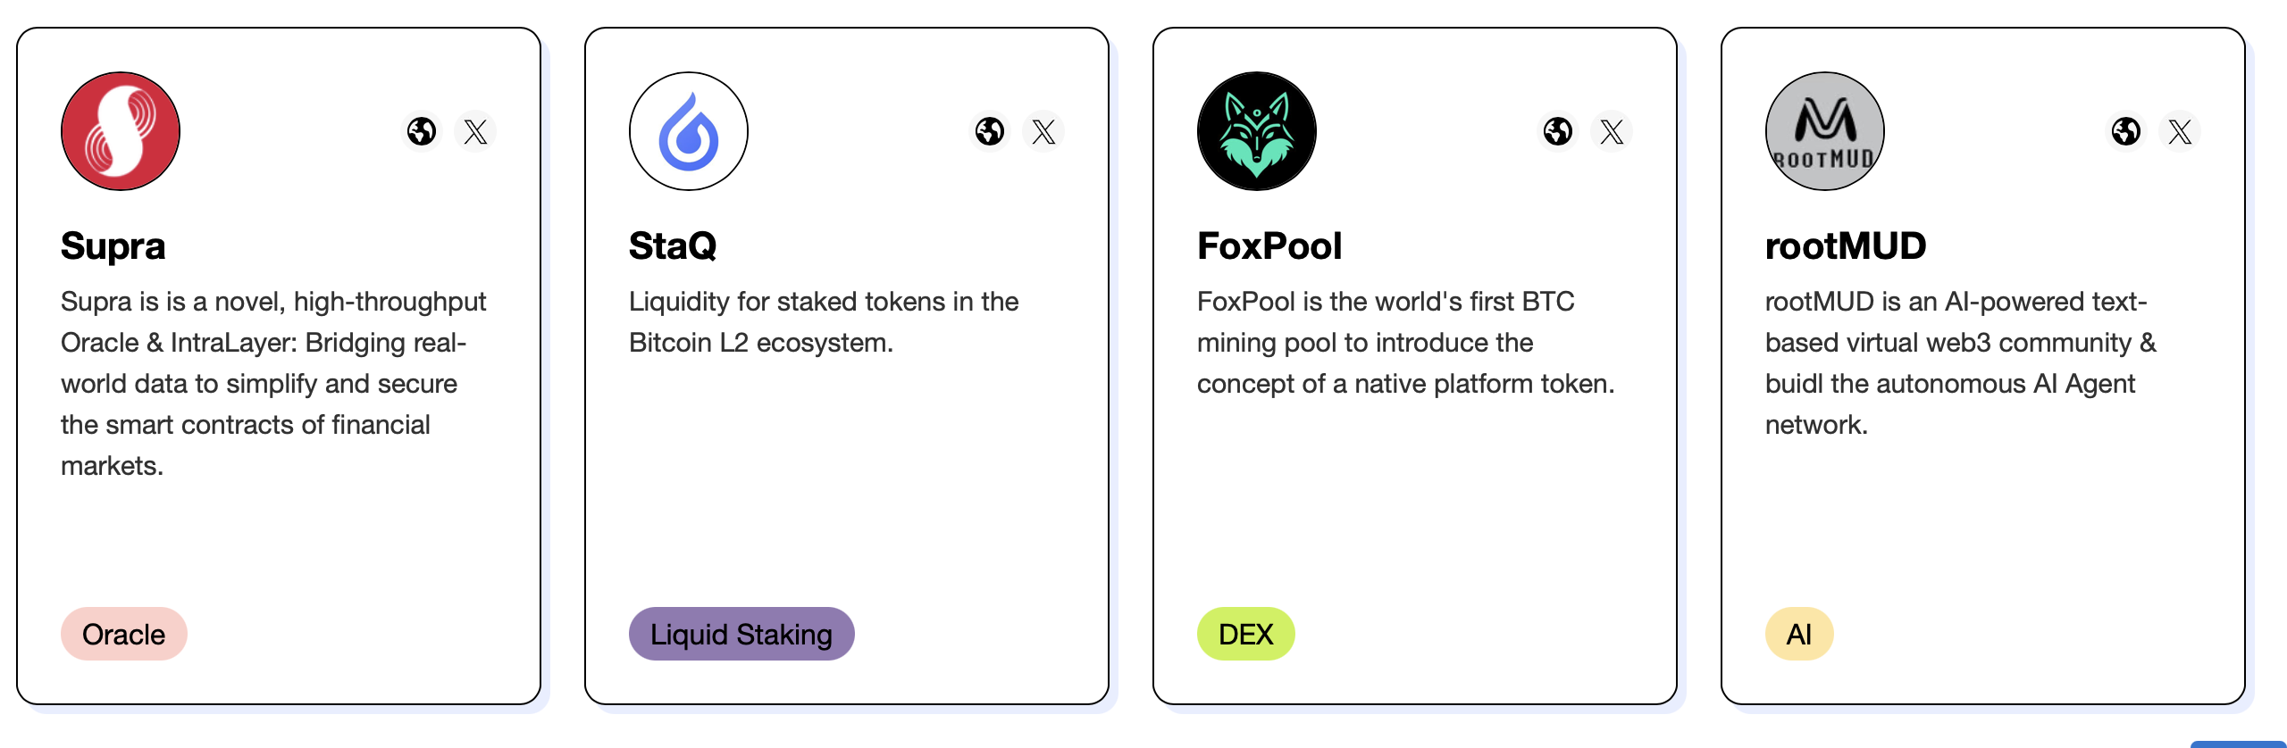
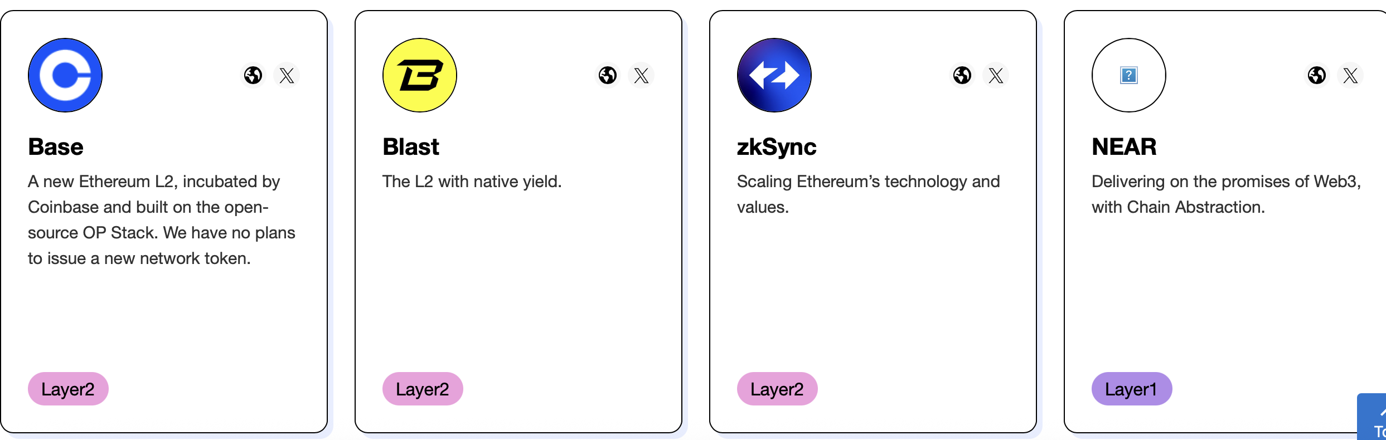
Real-world Deployment and Applications
Real-world Deployment
Relay 300,000+ Cross-chain Tx
among 8+ public chains
Worth 8 Million+ of USD
Support 50+ Dapps

Slide 9
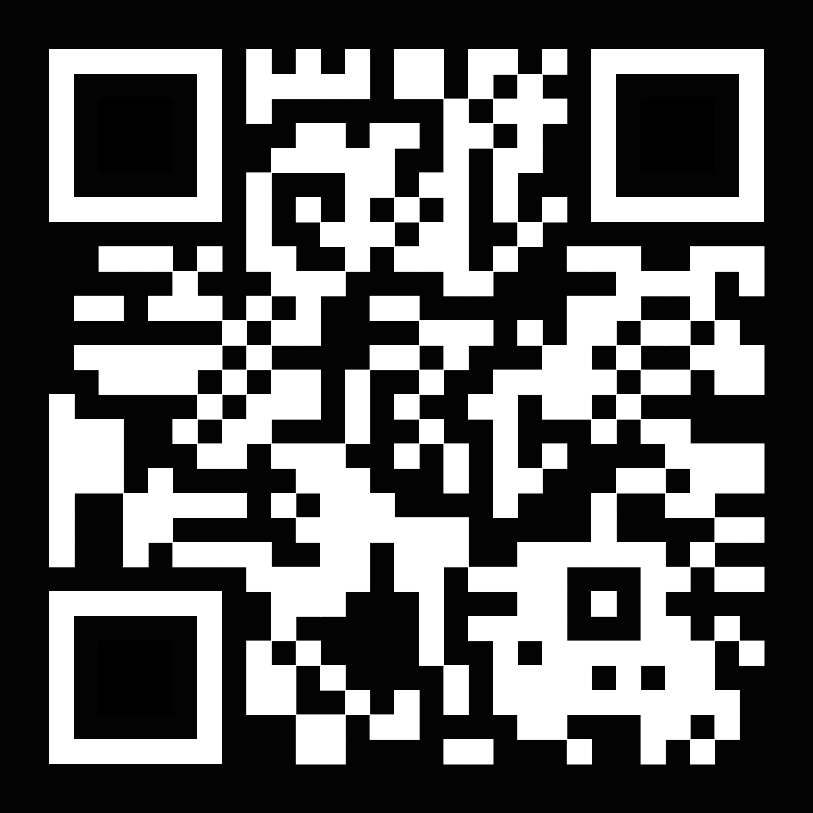
Q&A
Thanks for listening !
Yinfeng CAO
Email: yinfeng.cao@connect.polyu.hk
WeChat: Sliverwind99 MAP Official Site

